Slide 1
Senkou cards
Flashcards to memorize new topics
By
Wps Por-Favor (WPS)
Rami Chaouki, Caelan Seto, Ali Nehme

Slide 2

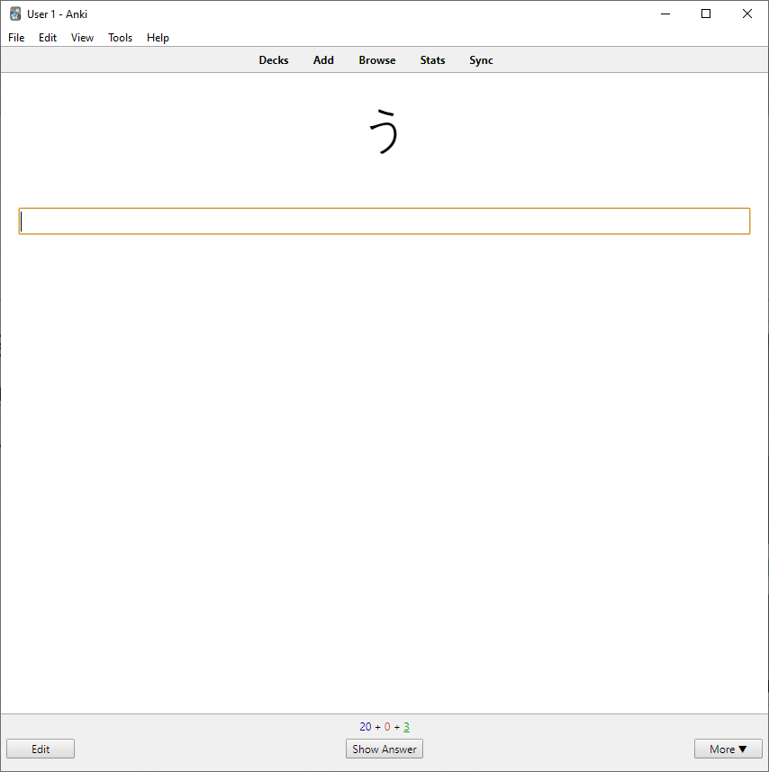
Background
Language learning App:
Top-Down: Memrize, Duolinguo
Bottom-up: Anki
Cloud based vs. Locally Run
Origin of Senkou (閃光) Cards

Slide 3
Senkou Cards
Availability: All information stored in Azure Cloud Database
Decks = sets of cards
Card = front (question) + back (answer = card name) + points (weight)
Rich text
Audio and images
User login, registration and offline
User score
Penalty on multiple attempts
Avoids increasing score by reattempting same quiz multiple times

Slide 4
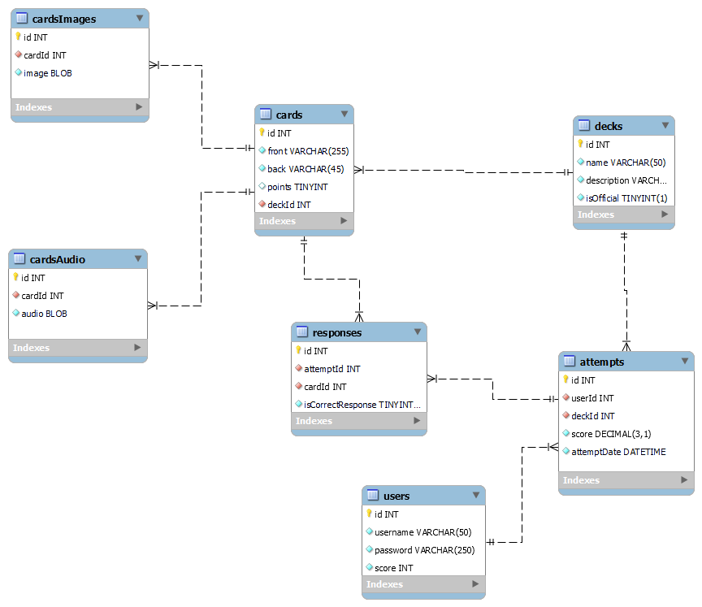
Database
Notes:
This is actually a simplified database, the original was meant to have a many to many relationship between the decks and the cards, meaning that a card could find itself in different decks. This foreshadows some of the most challenging aspects of this project, most notably maintaining a good idea in our head how everything was meant to work

Slide 5
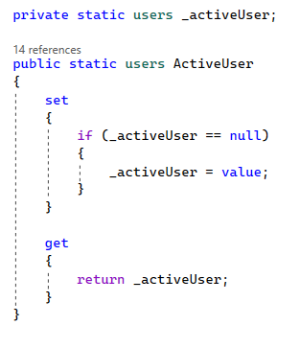
User
Run of the mill login – registration
Global user once logged-in
Offline mode – currently rudimentary

Slide 6
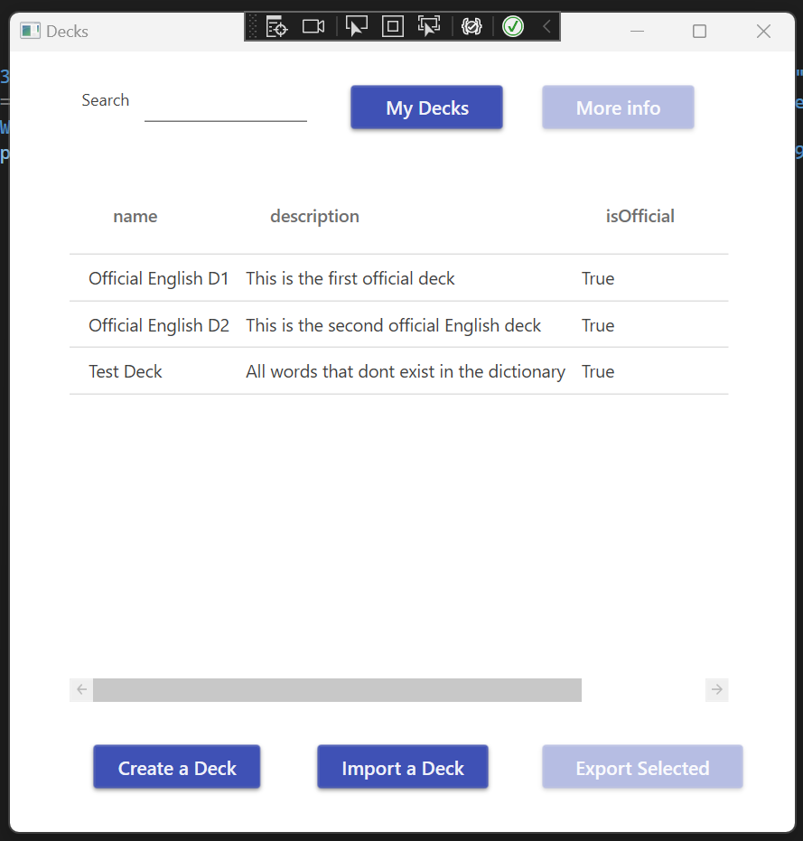
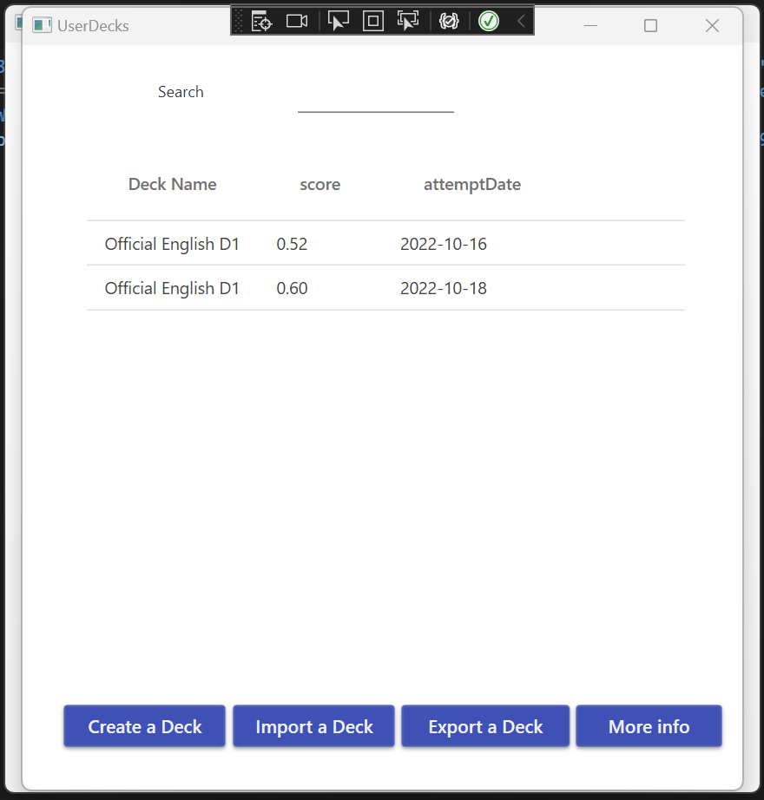
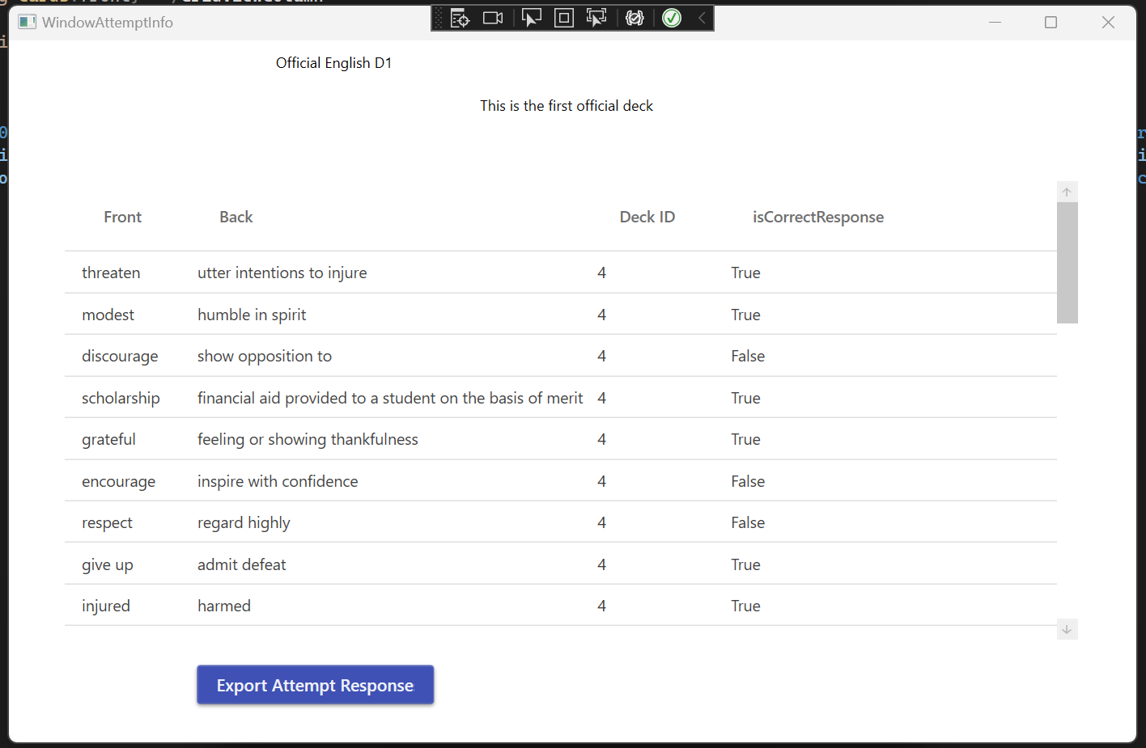
Decks
All Decks
User Attempts
Attempt responses

Slide 7
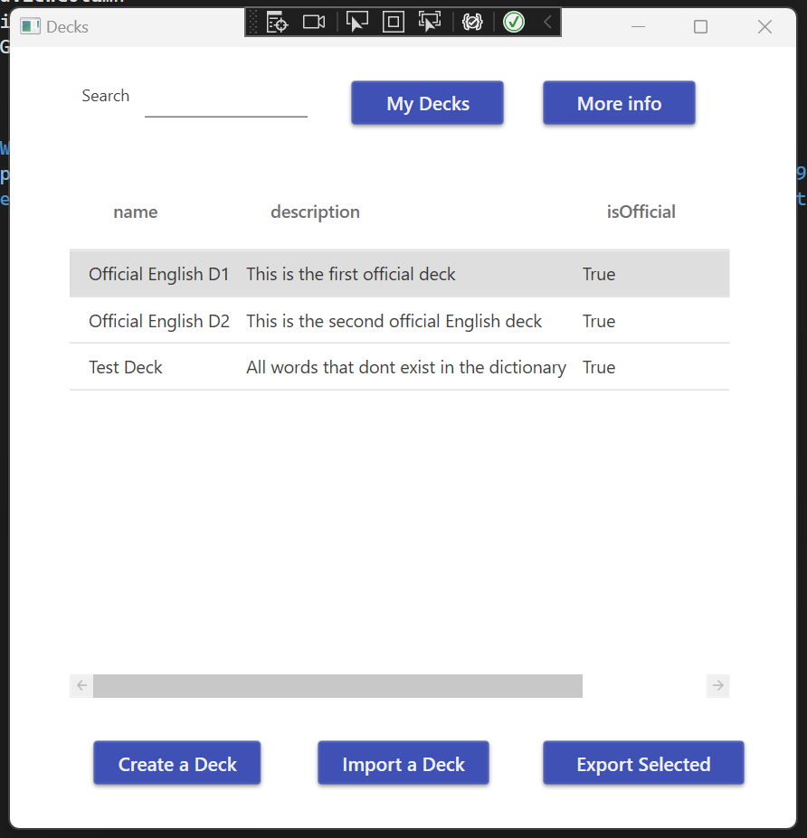
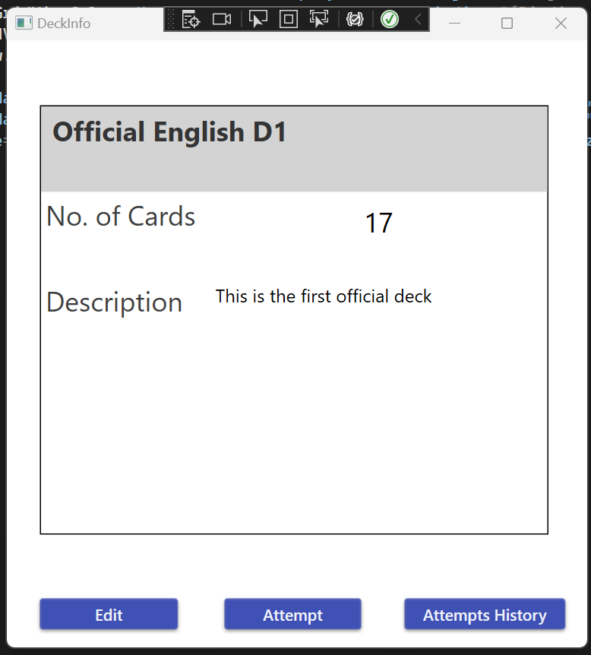
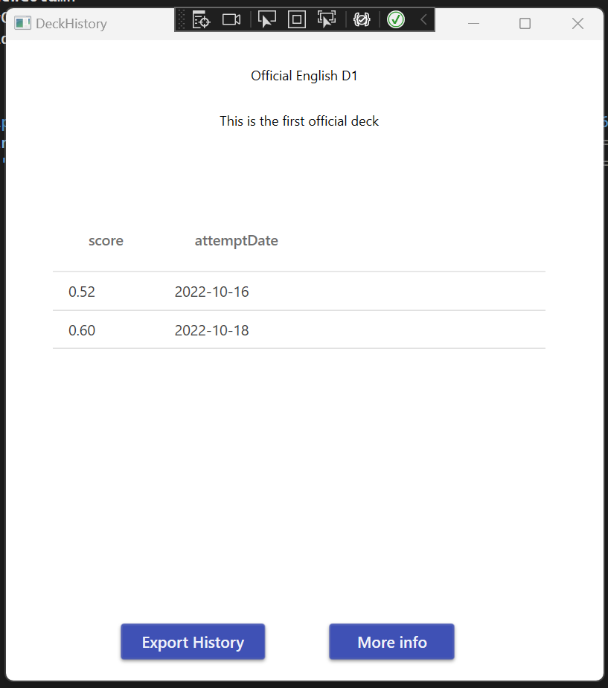
Decks
Select a Deck
Deck Info
Deck-specific attempts

Slide 8
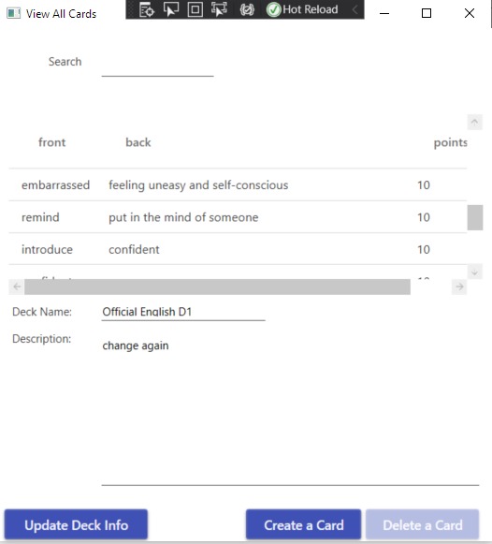
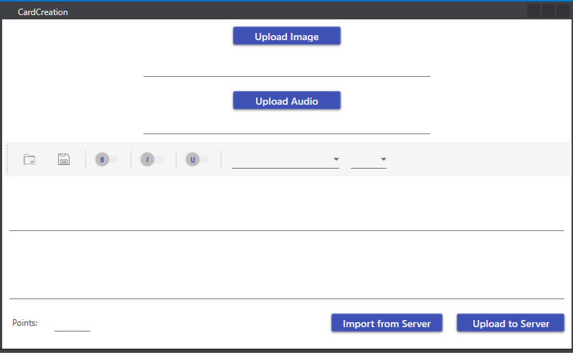
Cards
View All Cards
Create Card

Slide 9
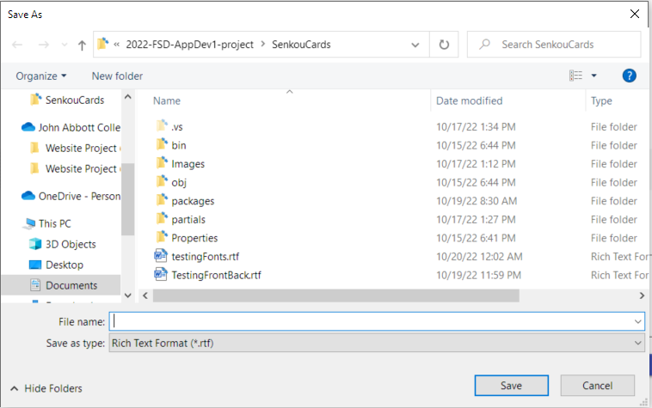
Rich Text

Slide 10
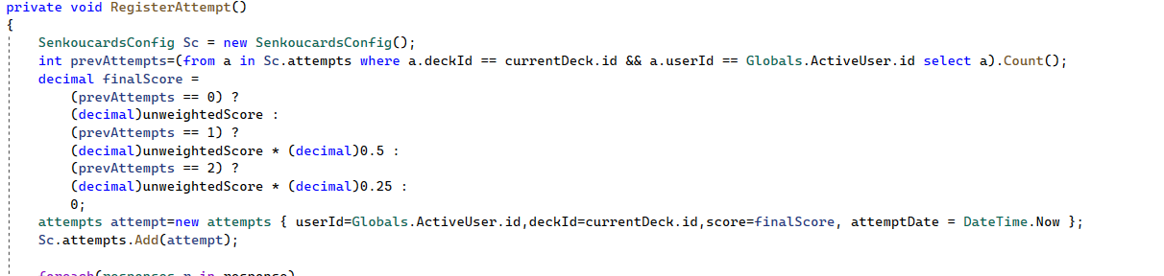
Quiz
Buttons Randomized
Oxford API
Securely Storing Keys
HTTP client
Weighted Scoring

Slide 11
Challenges and solutions
Things we have learned

Slide 12


Environmental Variables
AppSettings

Slide 13
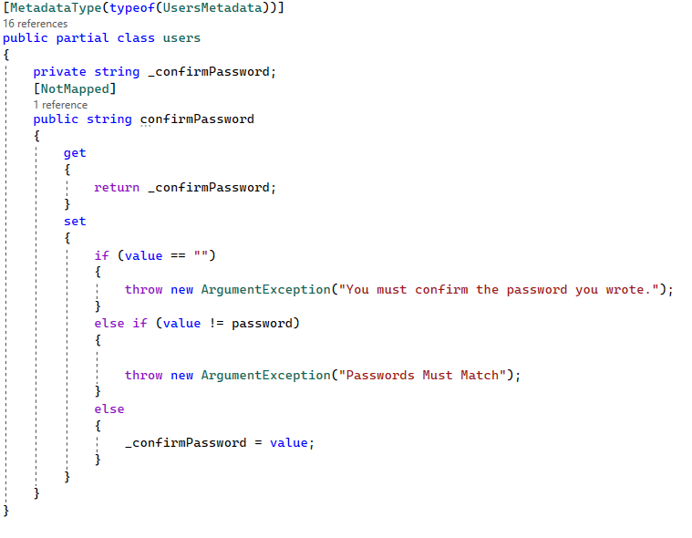
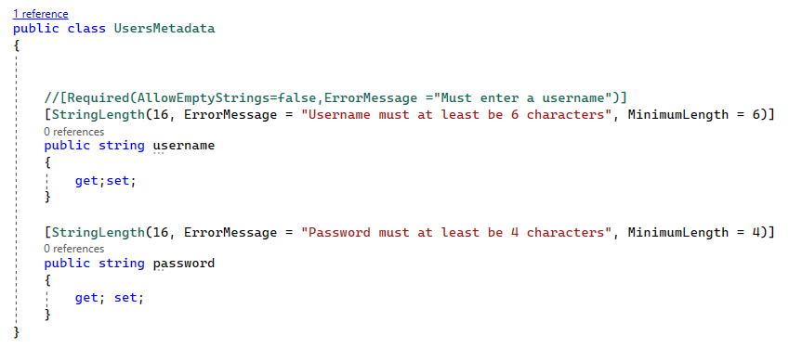
Field Validation
Database First Requires Partial Classes and Metadata

Slide 14
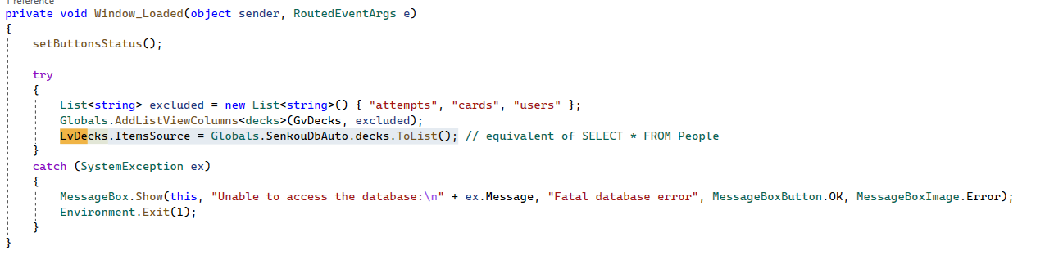
Optional Parameters

Slide 15
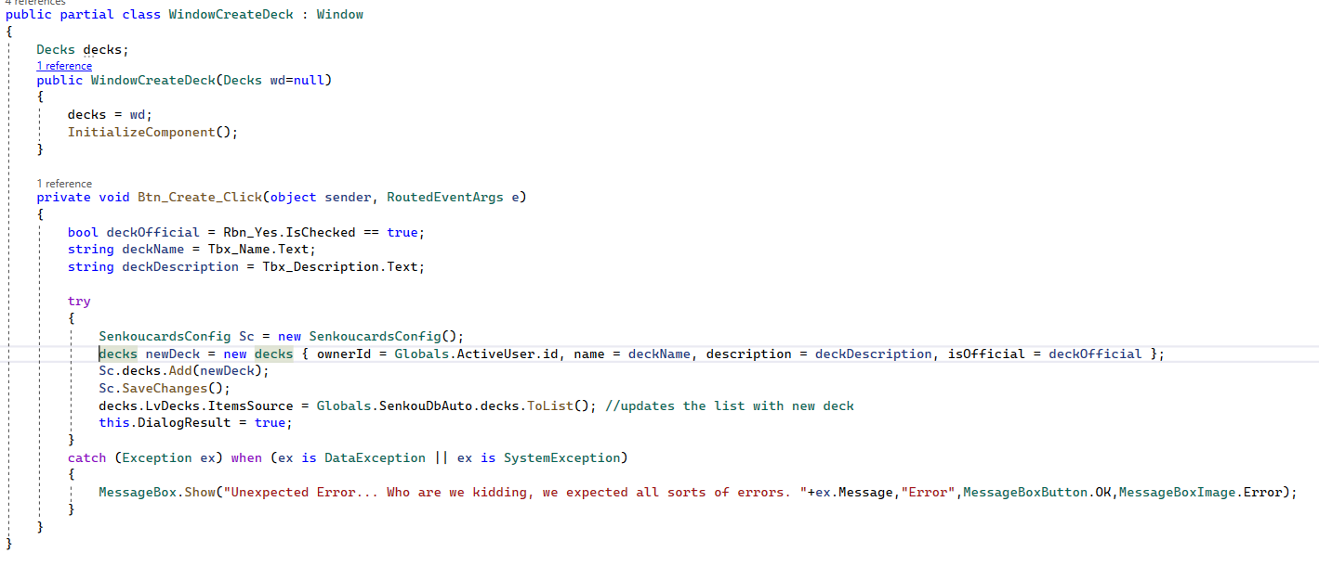
Optional Parameters

Slide 16
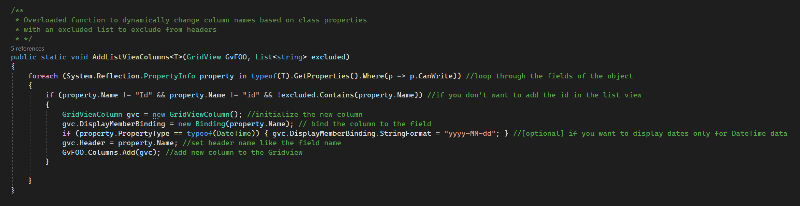
Generic Methods: Add columns < T > stands for "Type"
Method (Globals.ca)
XAML
Code behind

Slide 17
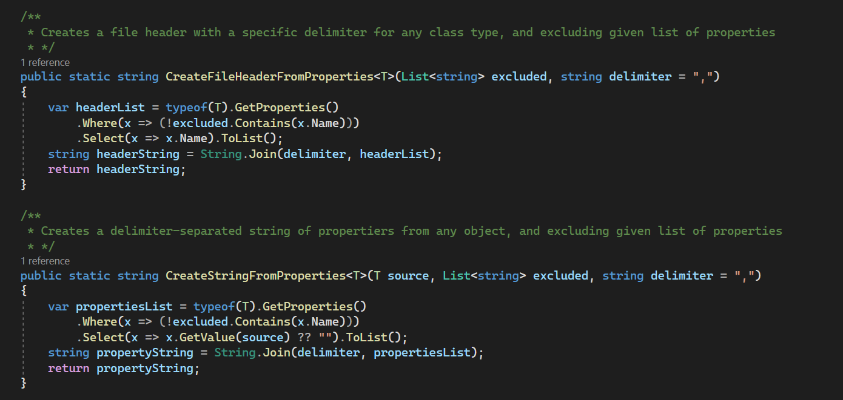
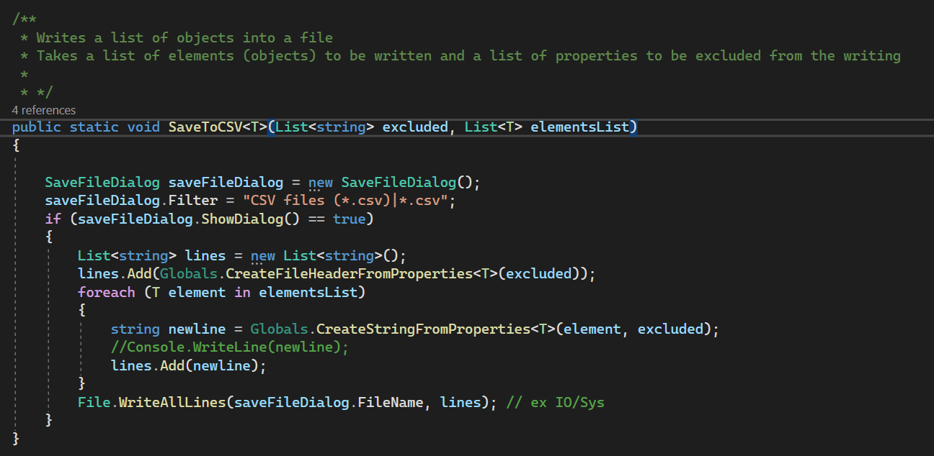
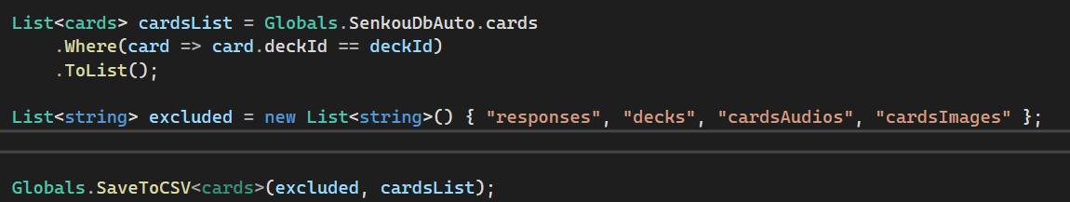
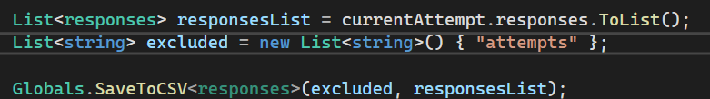
Generic Methods: Export to CSV
Create header and lines (strings)
write a list of elements into a
Exporting cards
Exporting responses

Slide 18
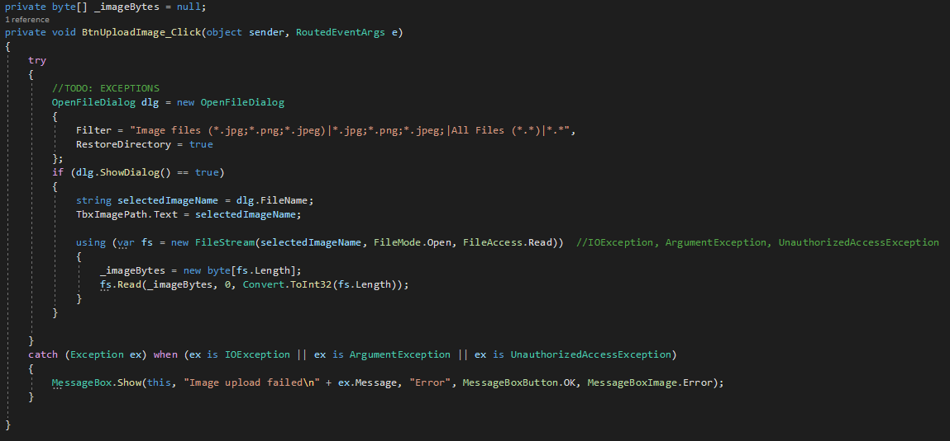
Blobs handling

Slide 19
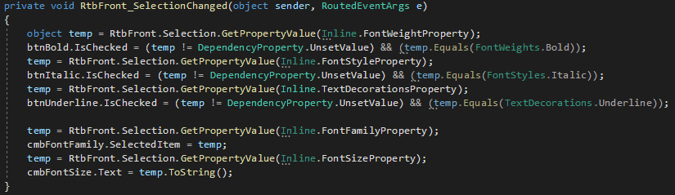
Rich text editor

Slide 20
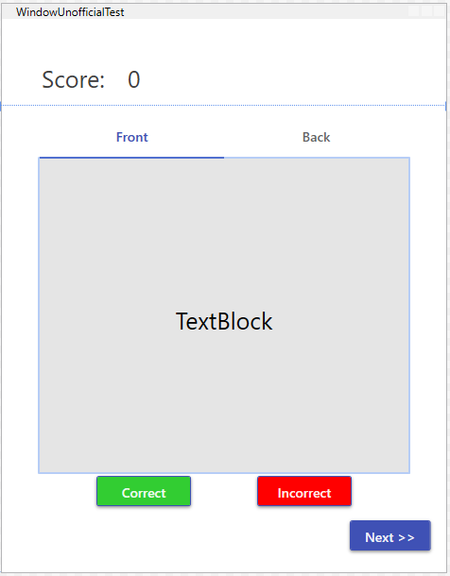
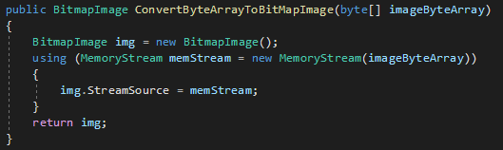
Future work
Import deck and cards
Develop offline (unranked) test from imported decks
Image- and audio-based quiz
Show answer
Deploy project
Rearrange the firewall settings to allow for anyone with the app to access it
Material Design

